Slide 1
Image clasification multilabel

Slide 2
OBJETIVO
Tienes una idea?
Voh! dale

Slide 3
Introducción
Machine Learning
AWS SageMaker

Slide 4
Machine Learning
What is Machine learning: "A computer program is said to learn from experience E with respect to some class of tasks T and performance measure P, if its performance at tasks in T, as measured by P, improves with experience E."
Tipos de Machine Learning
Supervised Learning
Unsupervised Learning

Slide 5
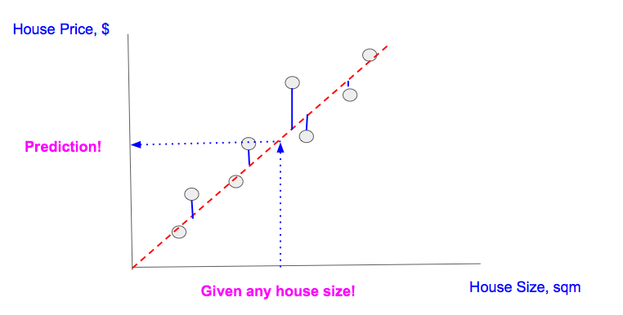
Machine Learning
Supervised Learning:
Linear regression

Slide 6
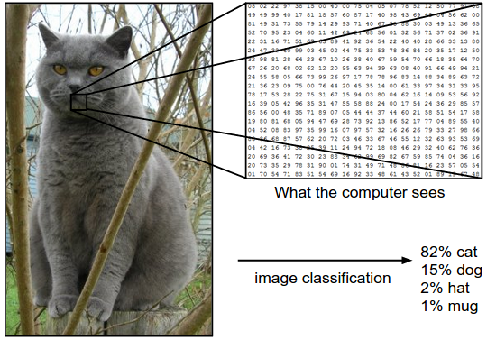
Machine Learning
Supervised Learning:
Image classificaction

Slide 7
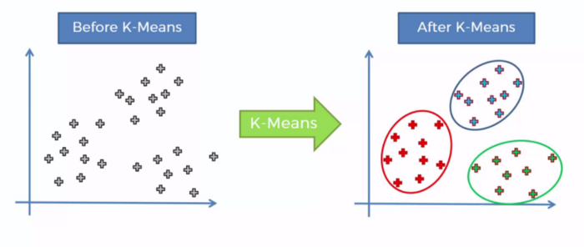
Machine Learning
Unsupervised Learning
K-Means

Slide 8
AWS SageMaker
Machine Learning Serivice
Integrated Jupyter notebook
Common Machine Learning algorithm (Optimizados para AWS)
Facturación por min de uso

Slide 9
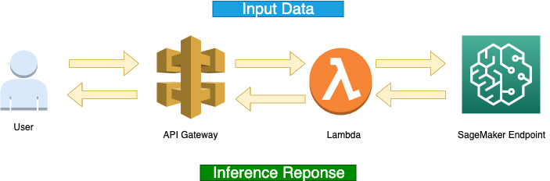
TALLER

